Slide 1
AI and Data : Shaping Tomorrow with Smart Algorithms
Lala Ibadullayeva
21.12.2024

Slide 2
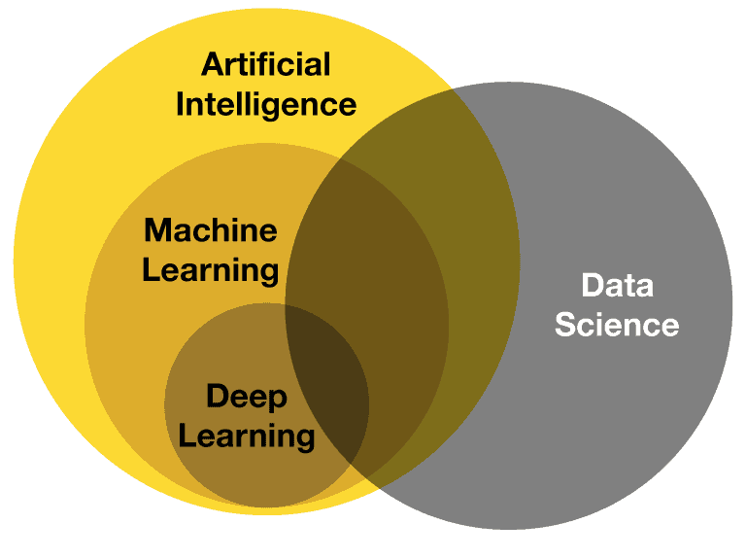

Data: The Fuel for AI
Data is often called the “new oil,” and for good reason.
Without data, AI would have nothing to learn from.
Every photo you upload, every GPS location you share, and every purchase you make generates data.
In fact, in today’s world, 2.5 quintillion bytes of data are created every single day.

Slide 3
Smart Algorithms: The Brain of AI
Smart algorithms are what make AI systems intelligent. An algorithm is simply a set of instructions, but smart algorithms can learn from data and improve themselves over time.
How do they work?
First, they train on historical data.
Then, they test on new data to ensure accuracy.
Finally, they are deployed to solve real-world problems.

Slide 4
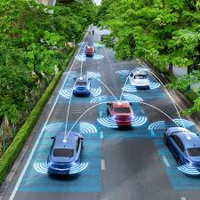

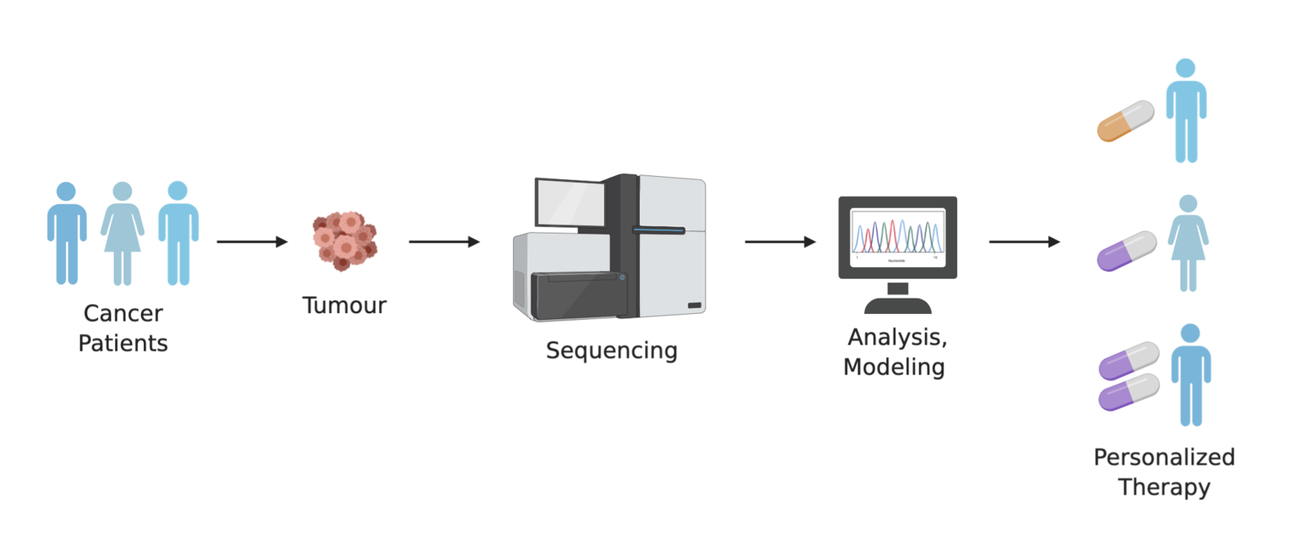
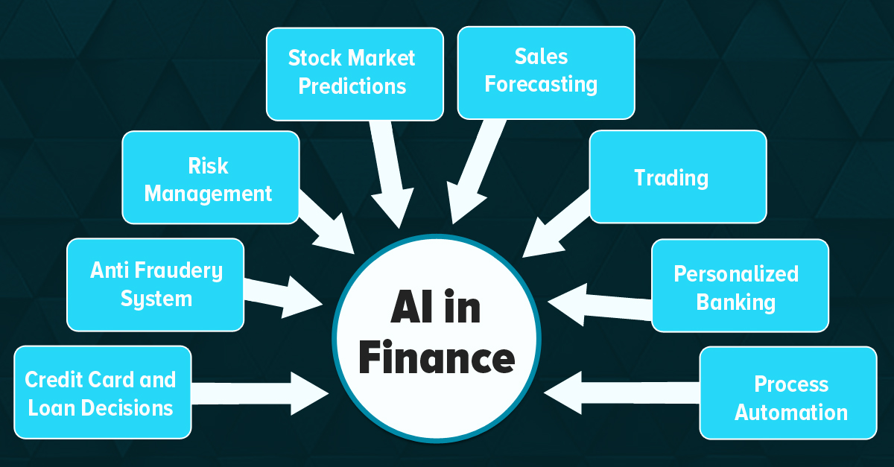
Practical Applications Shaping Our Future
Healthcare and Bioinformatics
Education
Finance
Transportation etc.

Slide 5
Healthcare and Bioinformatics
AI in Medical Imaging : Detecting Breast Cancer with AI
AI algorithms are extensively used in analyzing medical images such as X-rays, CT scans, MRIs, and mammograms. These algorithms help detect diseases like cancer, fractures, or neurological disorders at an earlier stage than traditional methods.
AI in Bioinformatics : AlphaFold by DeepMind
In bioinformatics, AI is revolutionizing genomics, proteomics, and drug discovery by analyzing complex biological data.
Personalized Medicine : AI in Genomic Medicine
AI is being used to tailor treatments to individual patients based on their genetic makeup, medical history, and lifestyle.

Slide 6
Other Examples
Education : Personalized Learning with Adaptive Platforms : Coursera’s AI Recommendation System
AI-driven platforms tailor educational content to each student's learning pace, preferences, and needs.
Finance : Fraud Detection and Prevention : PayPal’s Fraud Detection System
AI algorithms analyze transaction patterns to detect anomalies that may indicate fraudulent activity.
Transportation : Traffic Management Systems : Google Maps and Waze
AI optimizes traffic flow by analyzing real-time data from sensors, cameras, and GPS devices.

Slide 7
How can we do that type technologies?
You see different examples of AI technologies. The process :
Understand the Problem (Domain Knowledge)
Gather and Prepare Data
Explore and Analyze Data
Build Statistical and Predictive Models
Use Deep Learning for Complex Tasks
Optimize the Model
Deploy the AI Technology

Slide 8
Why Math is important for AI?
Mathematics is the foundation of Artificial Intelligence (AI). It provides the tools to design, analyze, and optimize AI algorithms. Without math, it would be impossible to understand how AI works, interpret results, or improve models.
Statistics: Understanding Data and Uncertainty (Descriptive Statistics, Inferential Statistics, Probability, Regression Analysis)
Linear Algebra (Vectors and Matrices, Eigenvalues and Eigenvectors, Matrix Decomposition, Systems of Linear Equations)
Calculus: Optimization and Change (Derivatives, Integrals, Chain Rule, Multivariate Calculus)

Slide 9
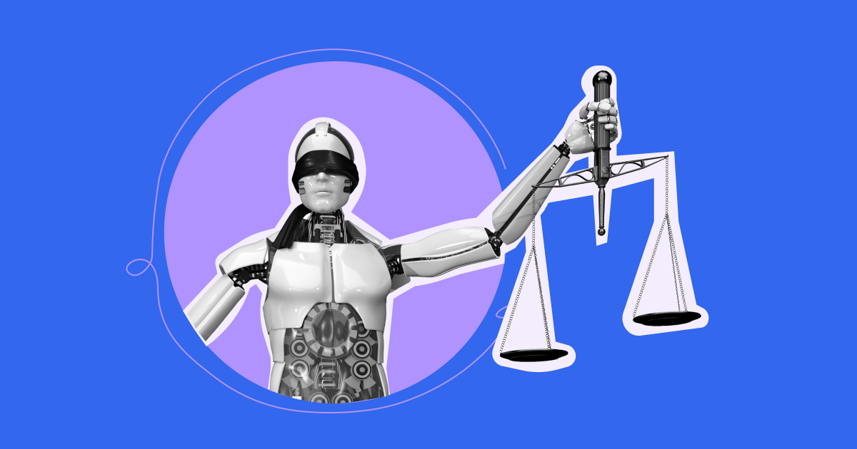
Ethical Considerations and Challenges and Solutions :)
Data Privacy : Healthcare AI, Smart Devices
Bias in AI : Hiring Systems, Judicial Systems
Job Displacement : Transportation, Retail

Slide 10


